Slide 1
Simplified Monochrome Television Transmitter
Samarjit Saha
ID:11809015
Session:2017-2018
Department of Information & communication Technology

Slide 2
Outlines of session
Basic of Monochrome TV Transmitter
Block Diagram of Monochrome TV Transmitter
Components of Block Diagram Monochrome TV Transmitter
Working of Monochrome TV Transmitter
Parameter of Monochrome TV Transmitter

Slide 3
Basic of Monochrome TV Transmitter
Black and White
Different Level of Brightness
Space and Time
Optical Domain
Conversion Of Optical Elements into electrical form
Scanning of Element

Slide 4
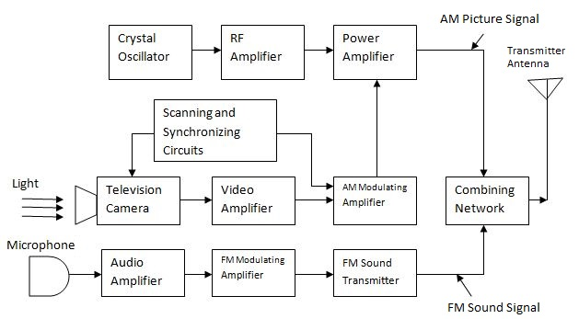
Block Diagram of Monochrome TV Transmitter

Slide 5
Parameter of Monochrome TV Transmitter
Video information between black and white with gray shade
UHF & VHF
RF carrier

Slide 6
Thanks Everyone For Listening

